Slide 1



Slide 2
POSTMAN SETUP

Slide 3
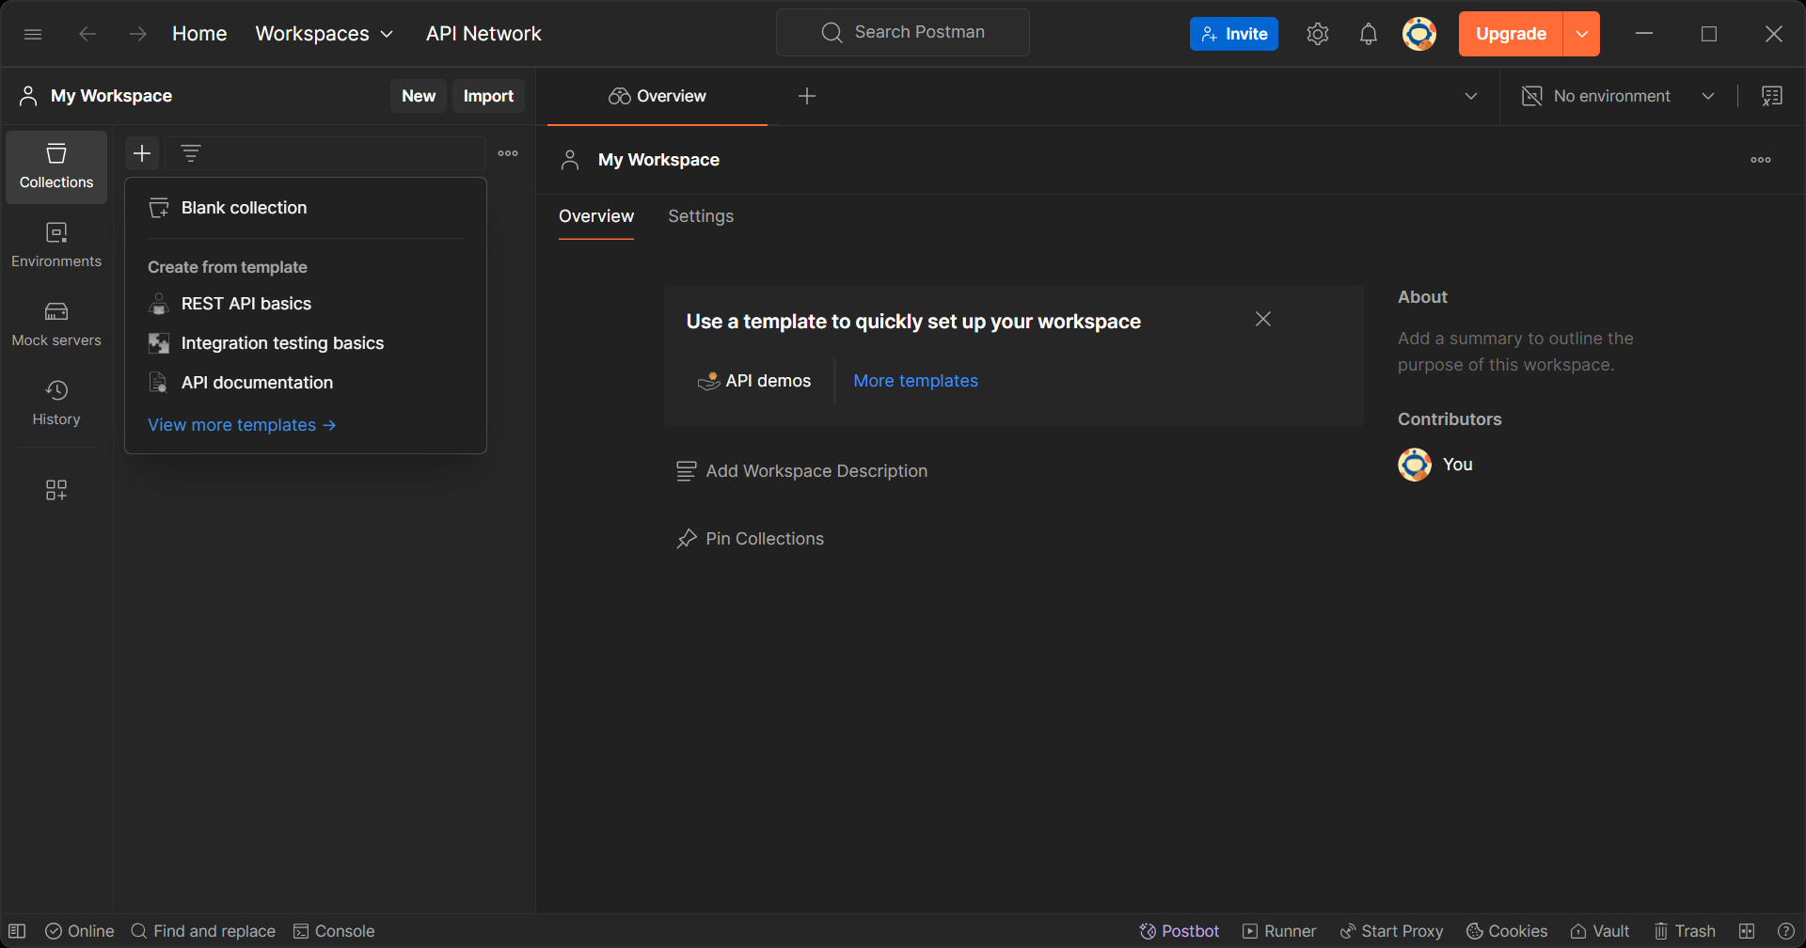
Open POSTMAN. At the collections tab, click + to create new blank collection.
1

Slide 4
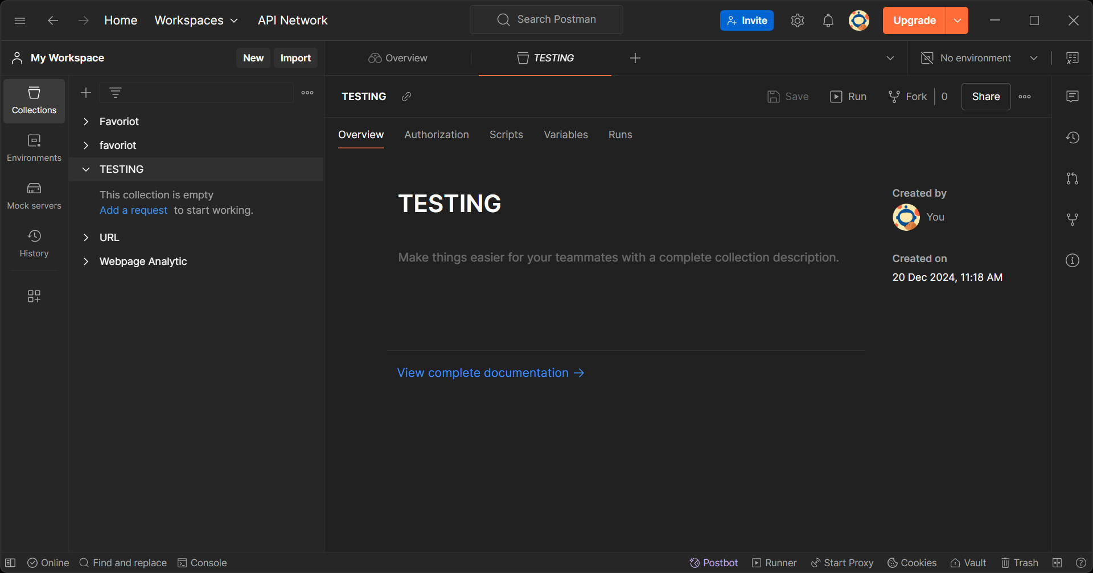
1
Name your collection.
2
Then, add request.

Slide 5
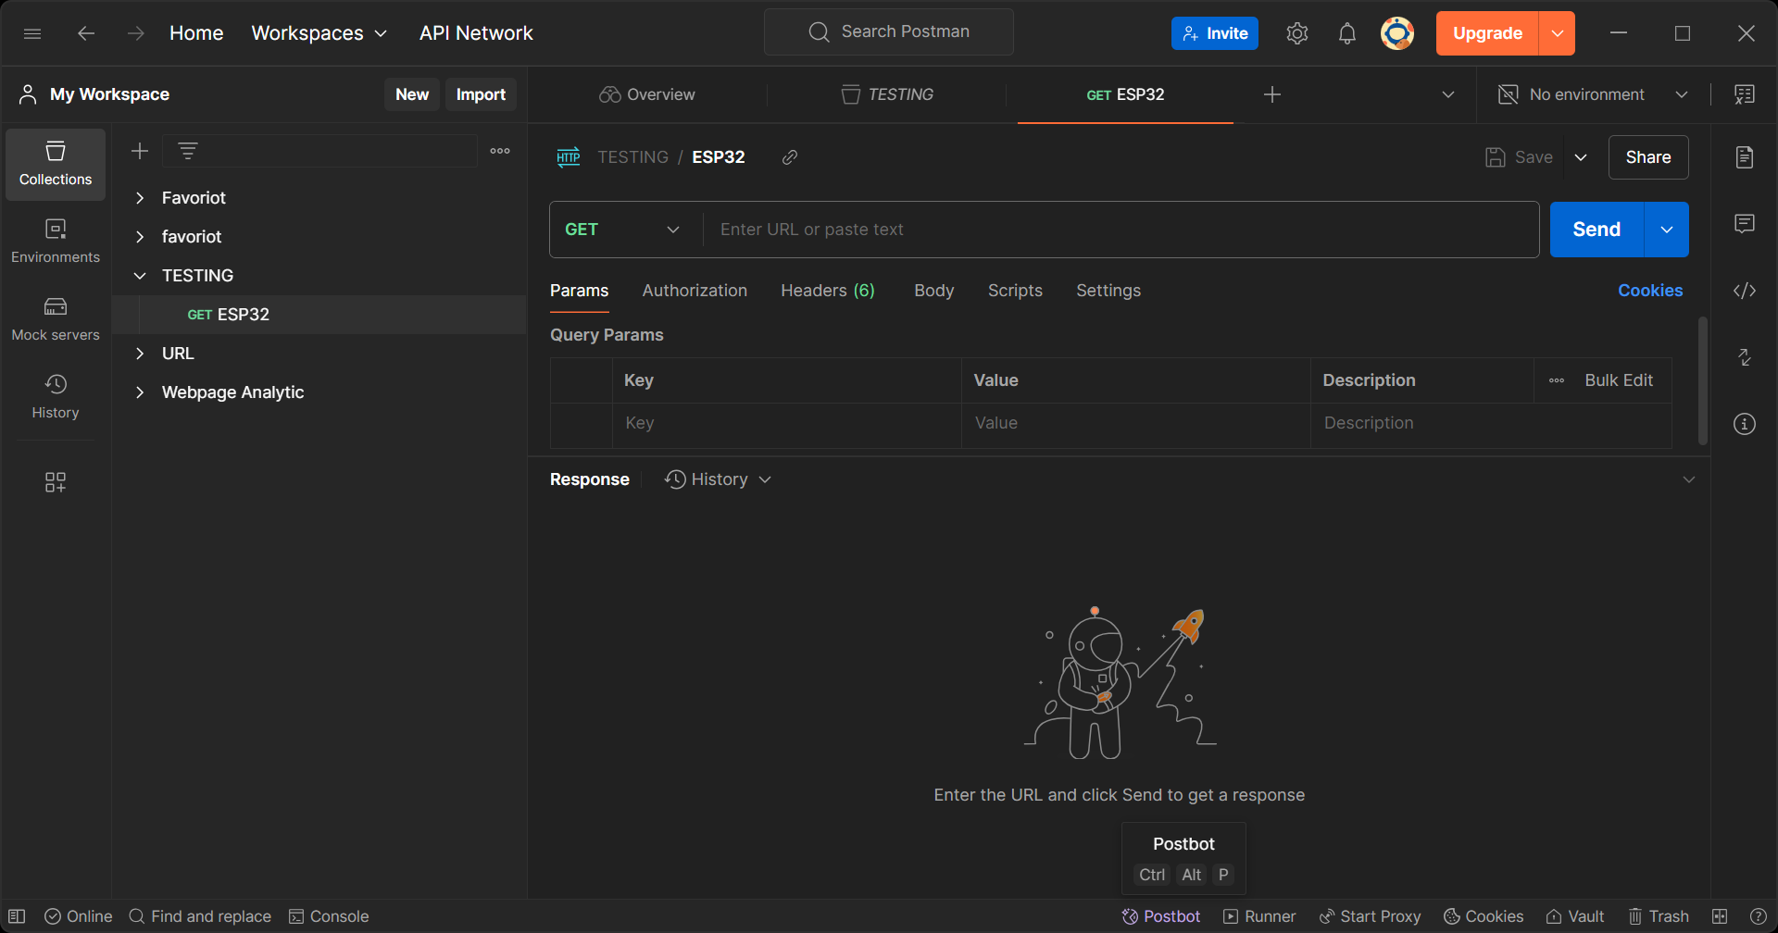
1
Name your request.
2
Then, choose the GET method.

Slide 6
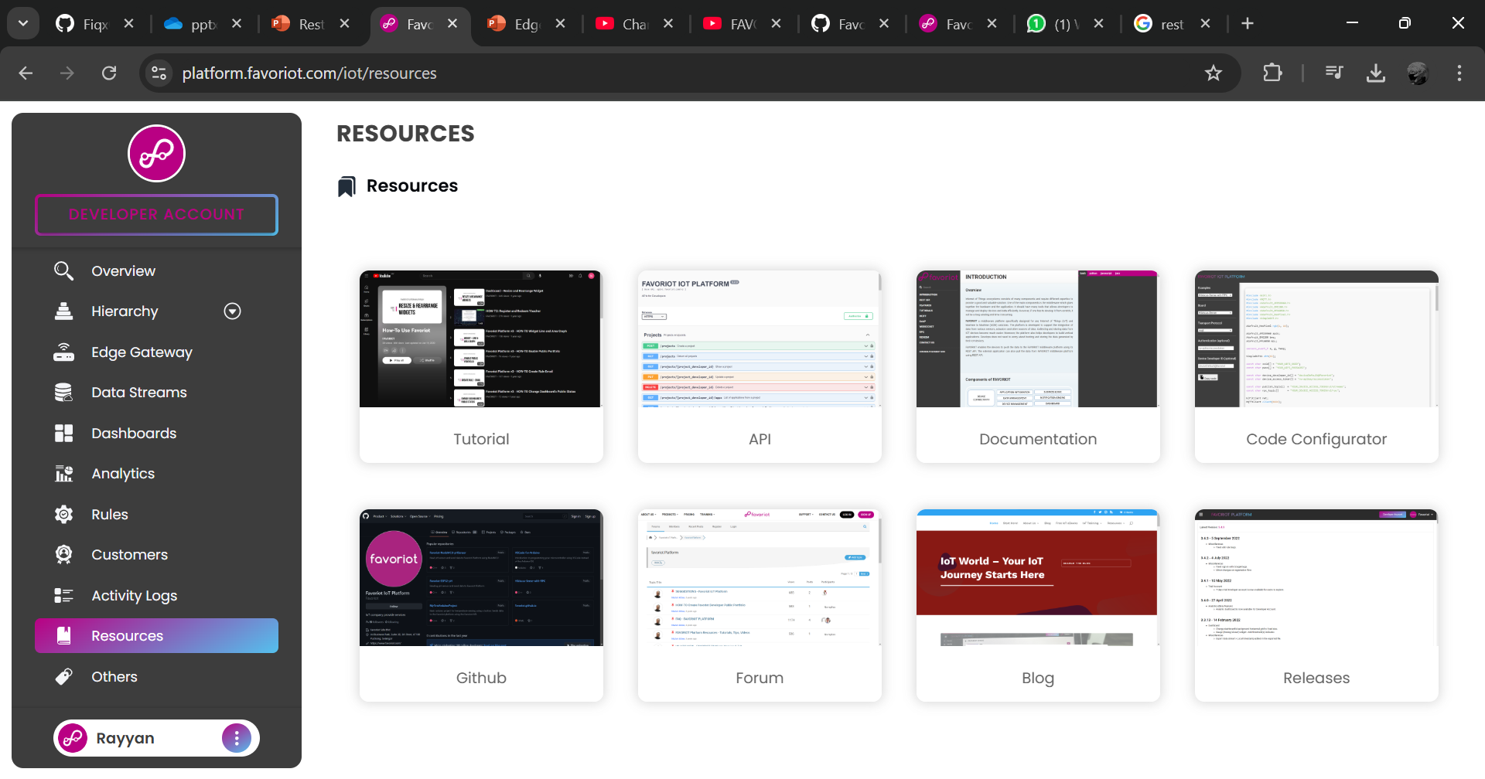
2
Then, open the documentation.
1
Log in to Favoriot account. Then, open the resources.

Slide 7
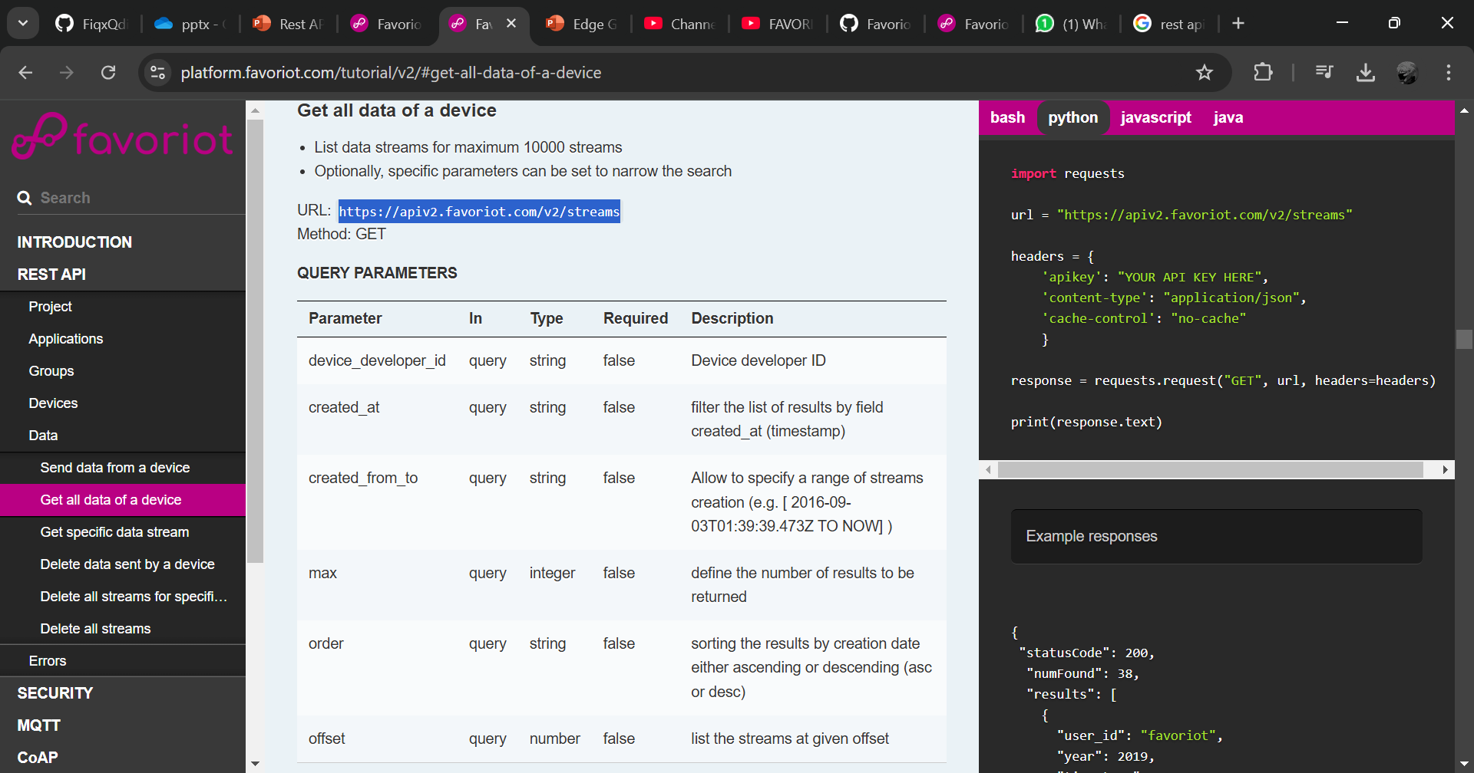
4
Then, copy the URL.
1
At the REST API section, under the data, click get all the data.
2
3

Slide 8
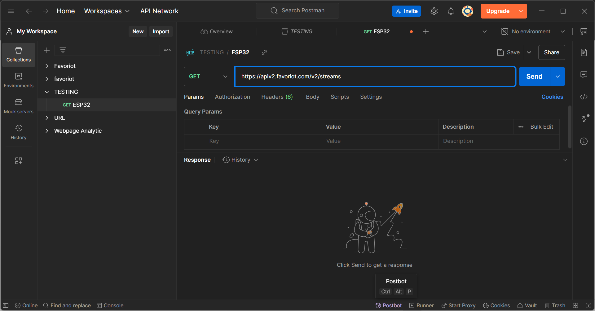
1
Then, paste the URL.
2
Then, fill in the query parameters.

Slide 9
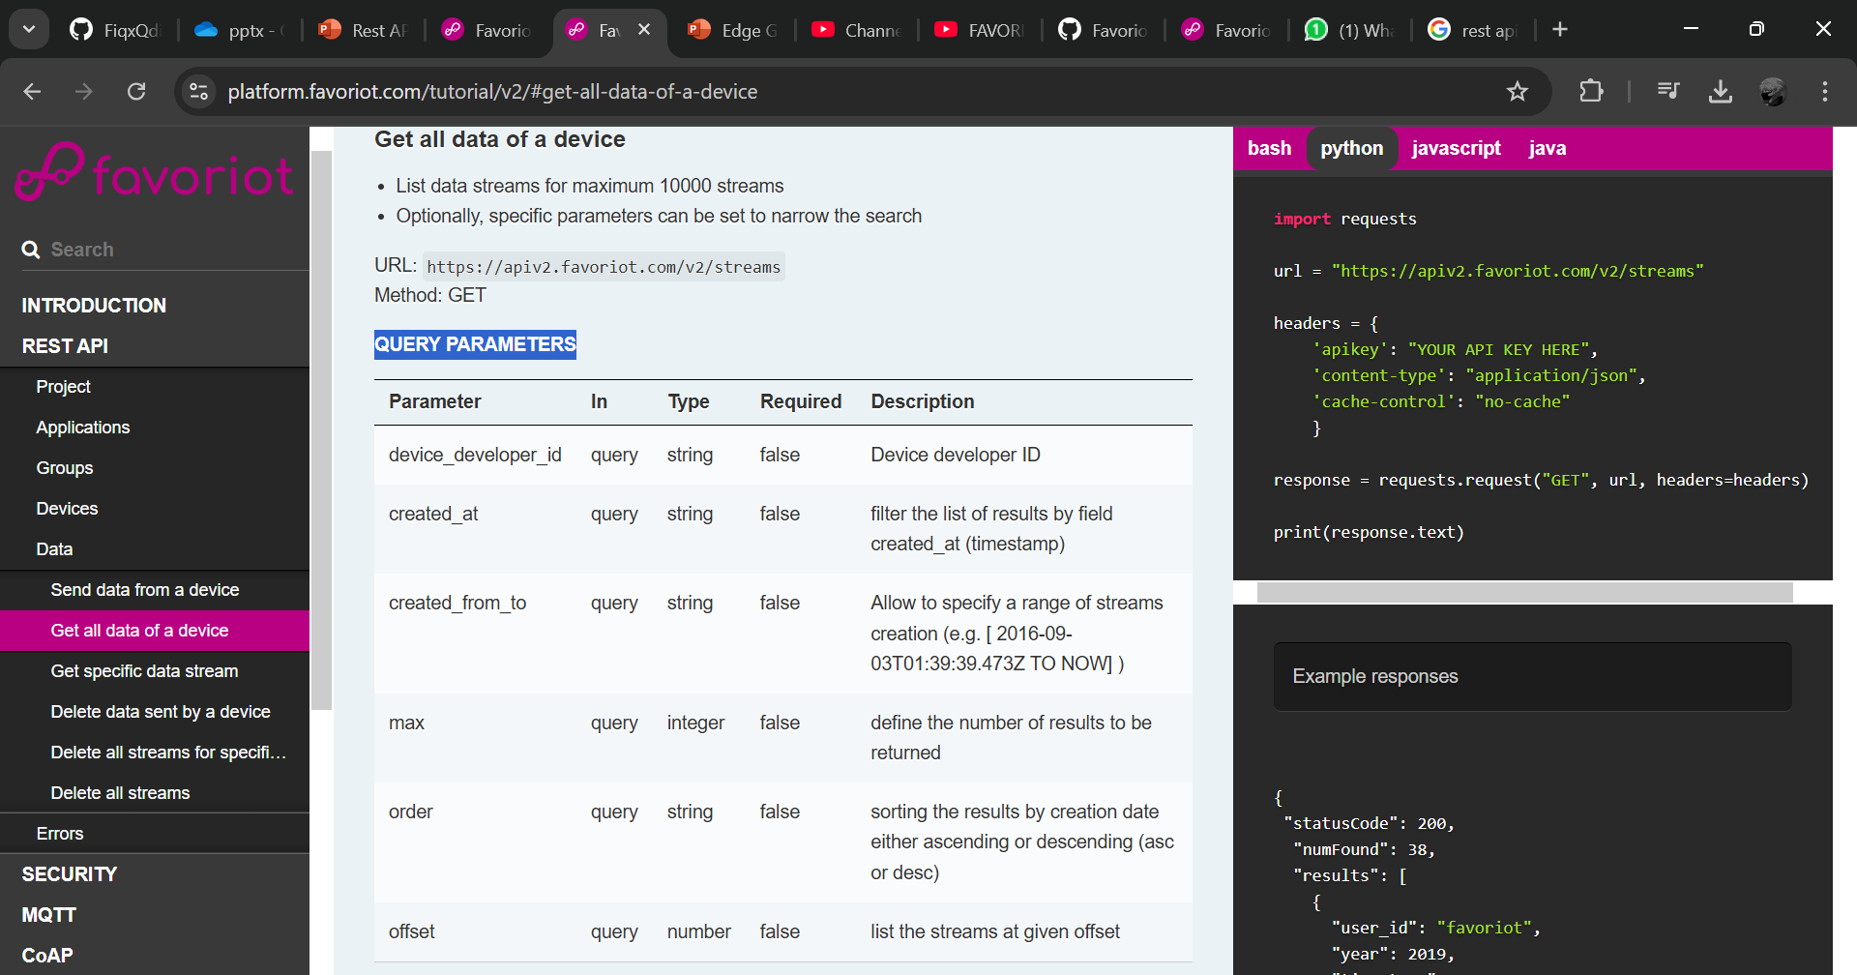
1
Below is the parameters that can be use.

Slide 10
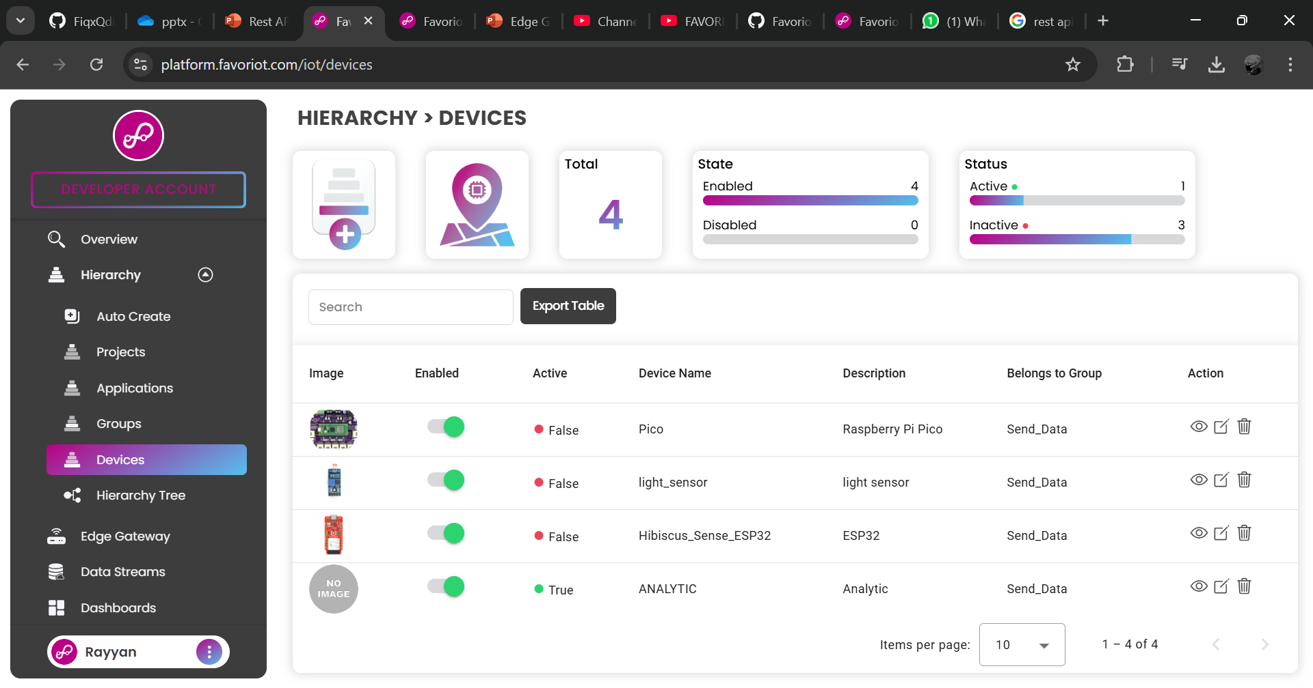
1
To find the device developer ID, need to click devices at the hierarchy.
2
Then, view the device.
3

Slide 11
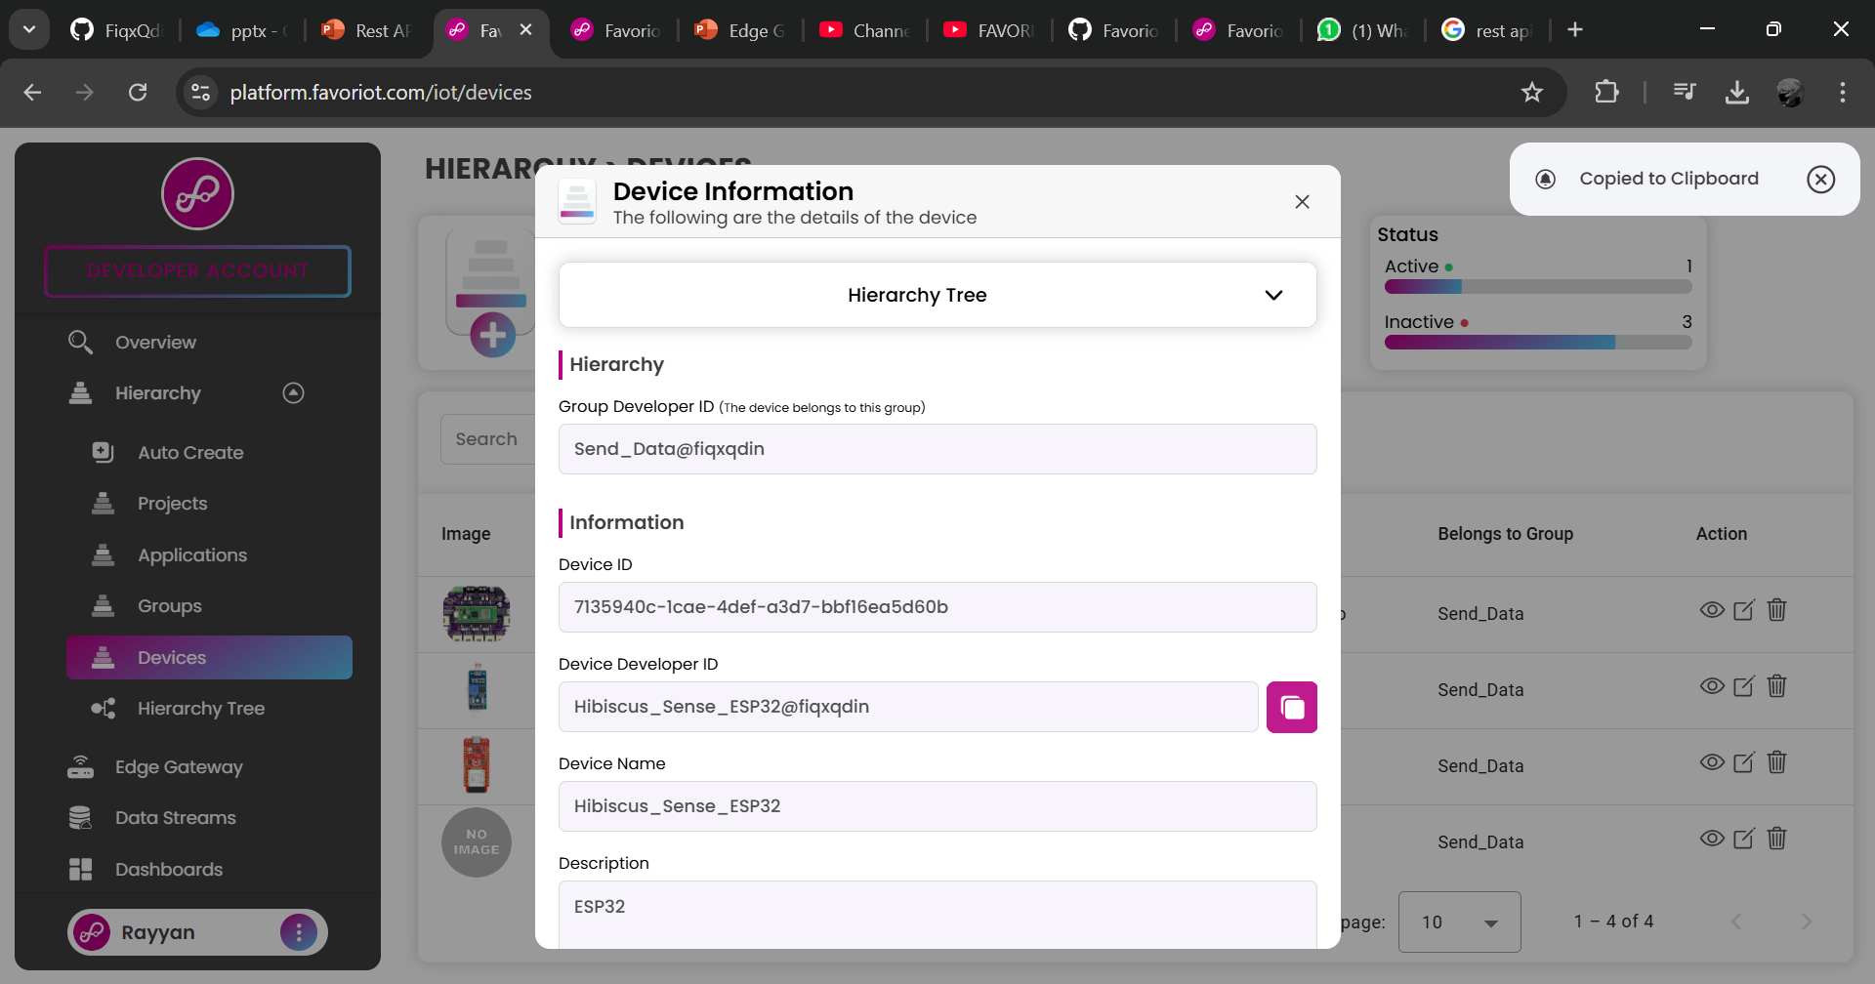
1
Next, copy the device ID.

Slide 12
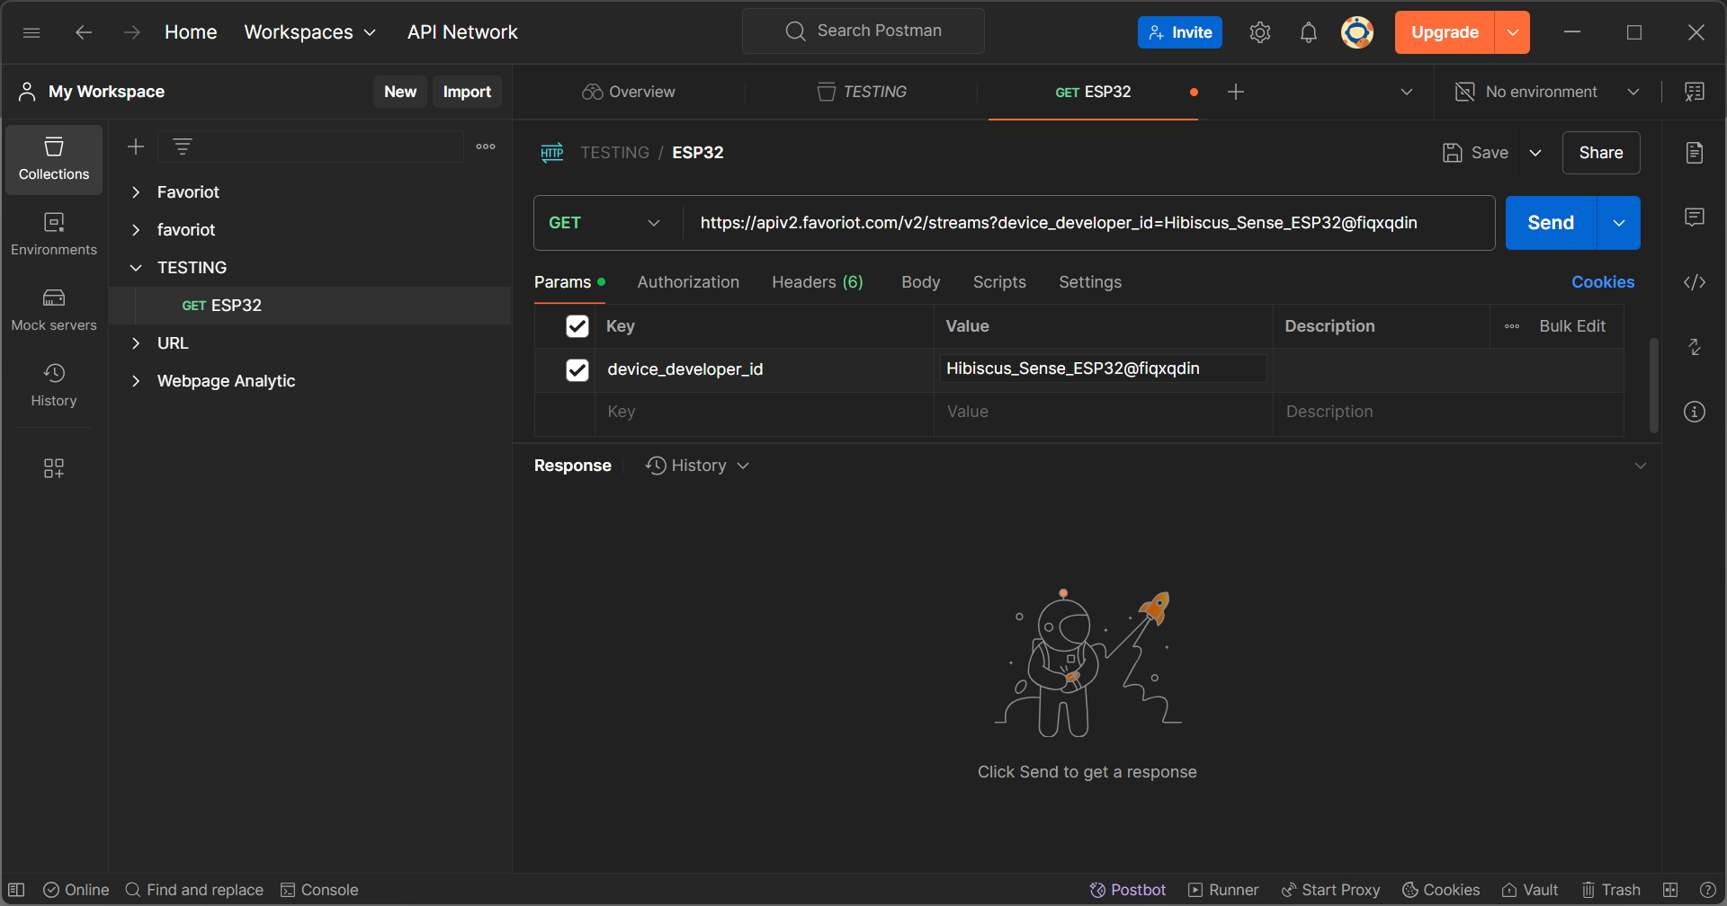
2
Then, open the headers section.
1
Fill in the parameters section.

Slide 13
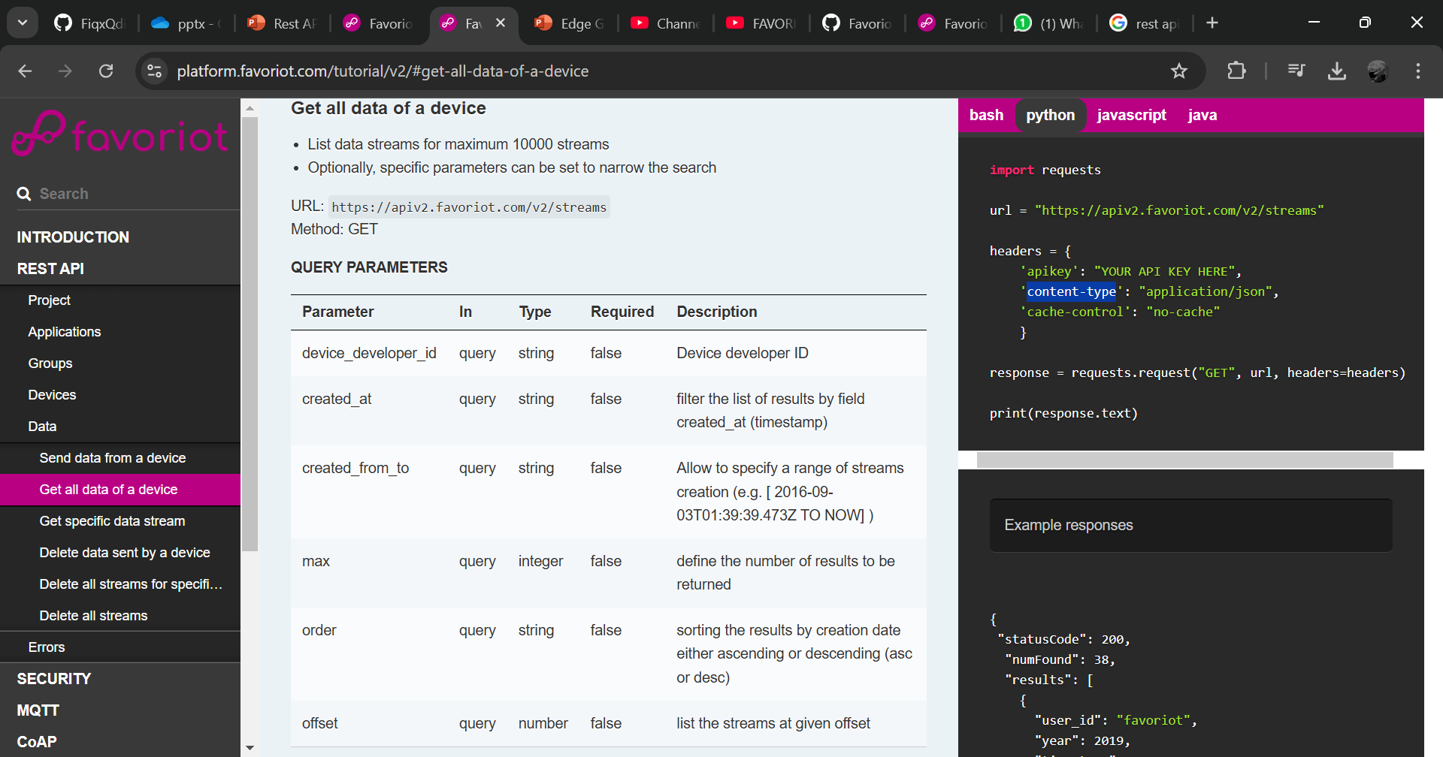
Headers need to put apikey and content-type.
1

Slide 14
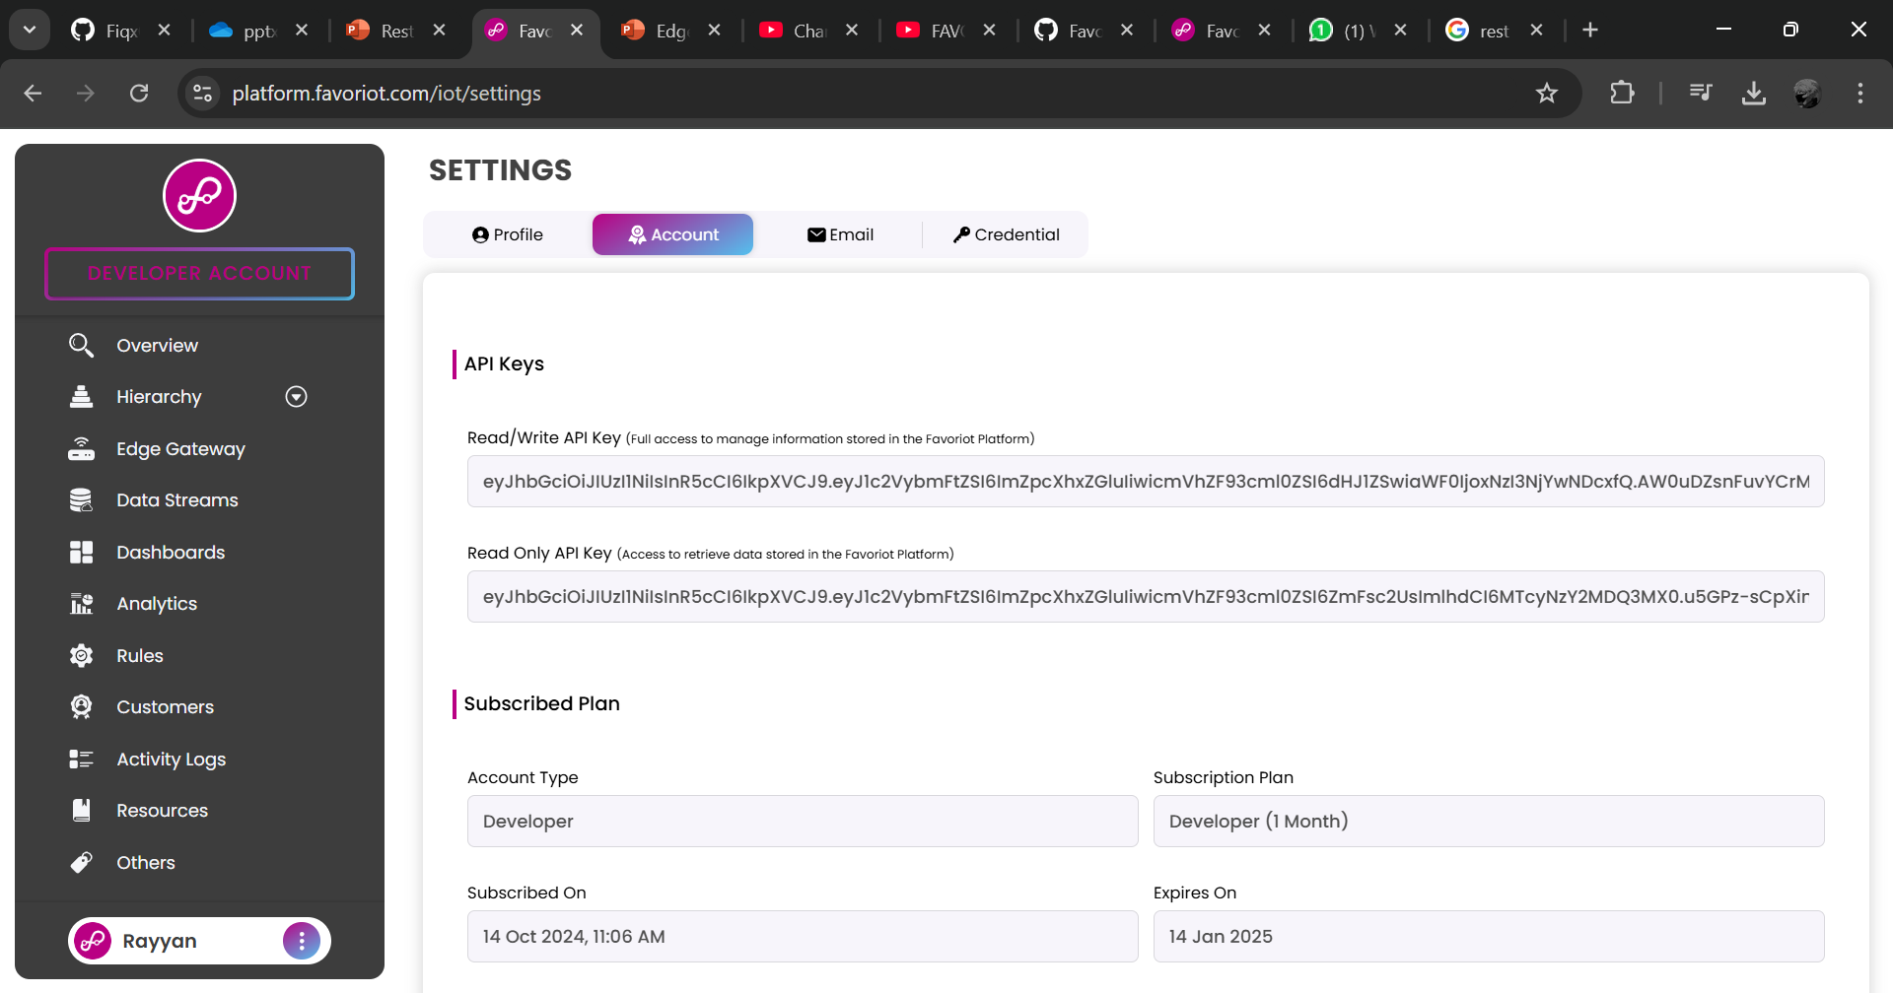
To find API key, need to open the account setting. Then, copy the API key.
2
1
3

Slide 15
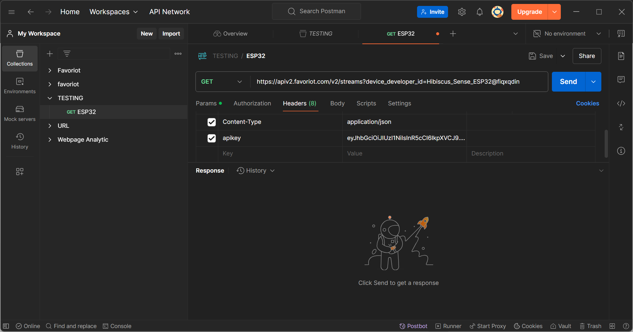
2
Fill in the headers section. Then, save the request.
1

Slide 16
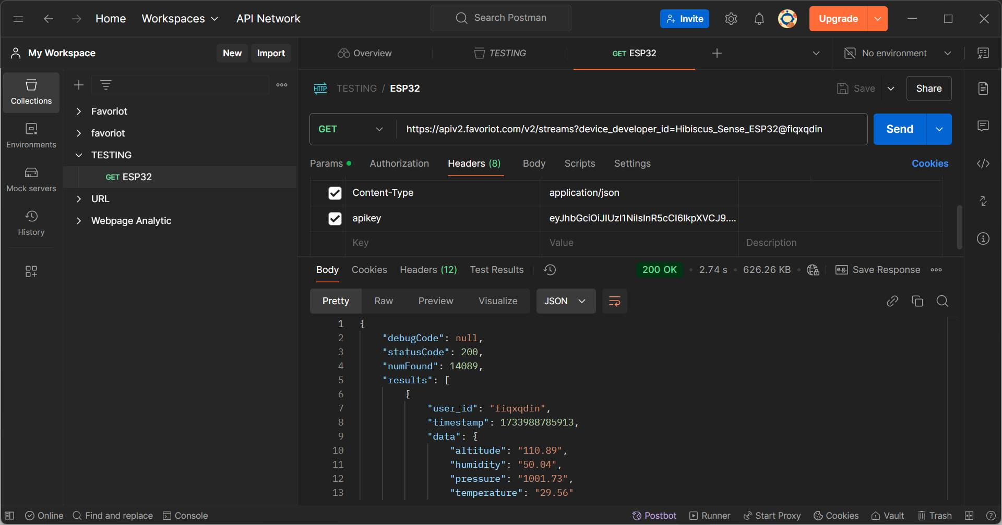
1
Then, click send to GET the data.
This is the JSON data from Favoriot data stream.
2

